Slide 1

Improved Object Detection for Small and Occluded Objects Using a Hybrid Feature Pyramid Network (HFPN)
Shubh Rakesh Nahar
Student ID: 1681276
Troy University
snahar@troy.edu

Slide 2

Introduction to Object Detection
Object detection locates objects within an image.
Challenges in detecting small and occluded objects.

Slide 3

Problem Statement
Current algorithms struggle with small and occluded objects.
Motivation for HFPN to improve accuracy.

Slide 4

Proposed Solution: HFPN
Overview of Hybrid Feature Pyramid Network (HFPN).
Goal: Improved detection accuracy for small/occluded objects.

Slide 5

Core Components of HFPN
Multi-Scale Attention Mechanism (MSAM).
Occlusion-Sensitive Feature Fusion (OSFF).
Enhanced Low-Level Feature Amplification (ELFA).

Slide 6

Feature Highlights of HFPN
Attention-based feature enhancement.
Occlusion-sensitive fusion.
Multi-level feature pyramid.

Slide 7
Advantages and Disadvantages
Advantages:
Improved small object detection.
Robust to occlusion.
Scalable.
Disadvantages:
Computationally expensive.
Increased complexity.

Slide 8
Comparison with Existing Algorithms
YOLO, Faster R-CNN, SSD, and HFPN comparison.
HFPN excels in small/occluded object detection.

Slide 9
Code Implementation Overview
Key functions in HFPN.
Custom attention and fusion functions implemented manually.

Slide 10
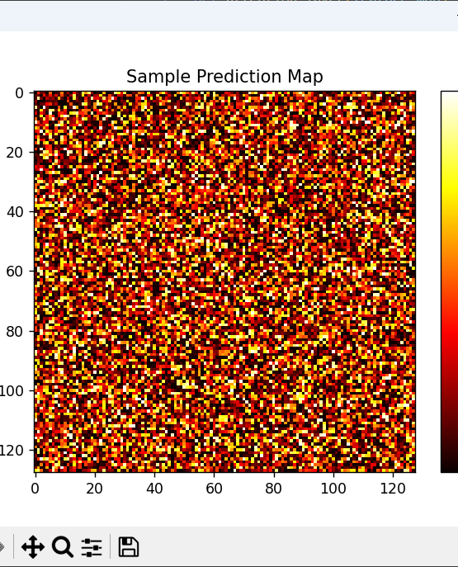
Simulation Results
Sample prediction map visualization.
Explains attention map significance and its role in HFPN.

Slide 11
Analysis of Results
Precision and recall improvements.
Inference and training time analysis.

Slide 12
Conclusion and Future Work
HFPN benefits for small/occluded object detection.
Potential for optimization to reduce computational cost.

Slide 13


Thank You
By Shubh Rakesh Nahar
Student ID - 1681276

